Slide 1
work SCHEDULEs
Provided by the LAUSD Food Services Division
Notes:
TELL: Welcome to the work schedule class. My name is (state your name) and I will be your facilitator.
ASK: What is the importance of work schedule in your daily operations? (Ask for a response from 3-5 students)
Possible responses:
Work schedule provides guidance to the staff on what to do and when to do the task
Work schedule is important because it enables a manager to reassign tasks when an employee is absent
TELL: Thank you for all your responses.
TELL: It is the food services division’s goal to train manager’s on how to plan and execute work schedules as a main tool for success in achieving work efficiency.

Slide 2
Work Schedule Benefits
Cafeteria work schedule is a tool used to assist in managing the cafeteria efficiently.
The benefits of work schedule include:
Saving on labor cost
Organizing employees
Designate specific tasks
Improves staffs productivity
Simplifies reassigning tasks when an employee is absent
Notes:
TELL: In today’s training our goal is to provide managers tools to assist in managing the cafeteria efficiently; ensure that you are compliance with the routine success requirements as well to be able to schedule your staff according to the operational needs

Slide 3
Overview
When designating tasks, define the task to ensure proper completion.
Collecting data to complete staff assignments
Establish clear expectations
Set attainable time frames
Use Cafeteria Work Assignment Schedule form
Annually update Individual Work Schedule
Evaluate the effectiveness of schedule
Notes:
TELL: Step 6. Define a Task Schedule.
When defining a task schedule, it simply asks that managers provide a more detailed step that is required to be able to complete a task.
Let’s discuss an example of a Task Schedule.
The following task schedules are examples for the most common work stations and cleaning procedures performed in cafeterias.
Task descriptions must be written in detail for each job duty. The description should also provide an expected outcome of the completed task.
For example, on the Work Schedule form 2381, you can write, ‘Break-down a meal service line”, however on the individual work schedule you can include the details such as
A task schedule makes the job easier for employees, managers and supervisors and helps to maintain good standards.
TELL: “PANNING OF FOOD” seems effortless or a very simple task. However, “PANNING OF FOOD” needs detail and attention that affects compliance in food safety as well as production when done incorrectly. A chronological task needs to be followed in order to perform this particular task.
Click on the next page for example.

Slide 4





Before You Begin
Before schedules are created, an understanding of the business and flow of the kitchen is needed. Analyze the following information:
Average Daily Participation (ADP)
Determine participation for specific days or meals
Bell schedule
Know the kitchens peaks and flows
Current staffing
Evaluate staff assigned hours
Cafeteria operation
Identify cafeteria tasks
Notes:
TELL: I hope that the previous slide provided some insight on some of the “why” questions in your mind on how our labor hours are allocated.
TELL: Now we move on to the eight steps required to be able to complete a work schedule.
Step 1. Obtain the bell schedule. Keep in mind the minimum days, you might want to have a separate work schedule just for this day .
This is vital to setting the period of time for which employees must be present in the operation. Obtain the serving schedules for all programs including After School service
Step 2. In order to calculate the daily participation at each meal period you will need to know this information. ADA helps you determine opportunities for improvement in the number of meals served, if you are not serving 70% or more of your daily population attending school.
Step 3. The ADP for each meal period must be used in determining the number of hours and staff needed at each period. Keep in mind the manager, senior and any other 6.5-hour workers should be accounted for first. The manager should be the opening worker, preparer and server for early breakfast in operations where very low participation exists or for BIC. Step 4, you must compile the information relating to the current staff. Pull together the staffing list, the classification of each employee and the work hours for each employee.
Step 5. When analyzing cafeteria operations, keep in mind what happens in a day’s operation or weekly basis depending on the menu cycle.
Step 6. Define a Task Schedule, it simply asks that managers provide a more detailed step that is required to be able to complete a task. (examples will be provided later)
Step 7, sequenced tasks with time duration. When determining the length of time, utilize the average number of minutes required to perform the task between the fastest, medium and slowest workers. This method can be utilized when the time and motion study is not available. Lastly, evaluate the effectiveness of the work schedule
ASK: In what way(s) can you evaluate that work schedule you have made is effective?
Possible Answer: As a manager, I can choose a day or time frame from the work schedule and shadow the employee to see if the tasks being completed on that day and time frame matches the tasks written on the work schedule. Tell: Thank you for participating.

Slide 5
Average Daily Participation (ADP)
Average daily participation is the average number of student reimbursable meals served per meal period.
Average Daily participation can assist with:
Forecasting staffing levels for
Breakfast
Lunch
Supper
Making informed decisions on labor
Knowing the ADP is essential to operating a successful cafeteria.
Notes:
TELL: I hope that the previous slide provided some insight on some of the “why” questions in your mind on how our labor hours are allocated.
TELL: Now we move on to the eight steps required to be able to complete a work schedule.
Step 1. Obtain the bell schedule. Keep in mind the minimum days, you might want to have a separate work schedule just for this day .
This is vital to setting the period of time for which employees must be present in the operation. Obtain the serving schedules for all programs including After School service
Step 2. In order to calculate the daily participation at each meal period you will need to know this information. ADA helps you determine opportunities for improvement in the number of meals served, if you are not serving 70% or more of your daily population attending school.
Step 3. The ADP for each meal period must be used in determining the number of hours and staff needed at each period. Keep in mind the manager, senior and any other 6.5-hour workers should be accounted for first. The manager should be the opening worker, preparer and server for early breakfast in operations where very low participation exists or for BIC. Step 4, you must compile the information relating to the current staff. Pull together the staffing list, the classification of each employee and the work hours for each employee.
Step 5. When analyzing cafeteria operations, keep in mind what happens in a day’s operation or weekly basis depending on the menu cycle.
Step 6. Define a Task Schedule, it simply asks that managers provide a more detailed step that is required to be able to complete a task. (examples will be provided later)
Step 7, sequenced tasks with time duration. When determining the length of time, utilize the average number of minutes required to perform the task between the fastest, medium and slowest workers. This method can be utilized when the time and motion study is not available. Lastly, evaluate the effectiveness of the work schedule
ASK: In what way(s) can you evaluate that work schedule you have made is effective?
Possible Answer: As a manager, I can choose a day or time frame from the work schedule and shadow the employee to see if the tasks being completed on that day and time frame matches the tasks written on the work schedule. Tell: Thank you for participating.

Slide 6
Bell Schedule
Depending on the day, school schedules can vary. Mealtimes (breakfast, lunch, supper) will vary depending on regular day, assembly day, minimum day, or any other variant.
Knowing the bell schedule is vital to ensure employee coverage.
Notes:
TELL: I hope that the previous slide provided some insight on some of the “why” questions in your mind on how our labor hours are allocated.
TELL: Now we move on to the eight steps required to be able to complete a work schedule.
Step 1. Obtain the bell schedule. Keep in mind the minimum days, you might want to have a separate work schedule just for this day .
This is vital to setting the period of time for which employees must be present in the operation. Obtain the serving schedules for all programs including After School service
Step 2. In order to calculate the daily participation at each meal period you will need to know this information. ADA helps you determine opportunities for improvement in the number of meals served, if you are not serving 70% or more of your daily population attending school.
Step 3. The ADP for each meal period must be used in determining the number of hours and staff needed at each period. Keep in mind the manager, senior and any other 6.5-hour workers should be accounted for first. The manager should be the opening worker, preparer and server for early breakfast in operations where very low participation exists or for BIC. Step 4, you must compile the information relating to the current staff. Pull together the staffing list, the classification of each employee and the work hours for each employee.
Step 5. When analyzing cafeteria operations, keep in mind what happens in a day’s operation or weekly basis depending on the menu cycle.
Step 6. Define a Task Schedule, it simply asks that managers provide a more detailed step that is required to be able to complete a task. (examples will be provided later)
Step 7, sequenced tasks with time duration. When determining the length of time, utilize the average number of minutes required to perform the task between the fastest, medium and slowest workers. This method can be utilized when the time and motion study is not available. Lastly, evaluate the effectiveness of the work schedule
ASK: In what way(s) can you evaluate that work schedule you have made is effective?
Possible Answer: As a manager, I can choose a day or time frame from the work schedule and shadow the employee to see if the tasks being completed on that day and time frame matches the tasks written on the work schedule. Tell: Thank you for participating.

Slide 7
Current Staffing
When making schedules evaluate the following to provide the staffing needed for the operation:
Current staffing levels
Staff start and end times
Break times
Assignment rotation
Knowing the current staffing will allow for efficient and effective schedules.
Notes:
TELL: I hope that the previous slide provided some insight on some of the “why” questions in your mind on how our labor hours are allocated.
TELL: Now we move on to the eight steps required to be able to complete a work schedule.
Step 1. Obtain the bell schedule. Keep in mind the minimum days, you might want to have a separate work schedule just for this day .
This is vital to setting the period of time for which employees must be present in the operation. Obtain the serving schedules for all programs including After School service
Step 2. In order to calculate the daily participation at each meal period you will need to know this information. ADA helps you determine opportunities for improvement in the number of meals served, if you are not serving 70% or more of your daily population attending school.
Step 3. The ADP for each meal period must be used in determining the number of hours and staff needed at each period. Keep in mind the manager, senior and any other 6.5-hour workers should be accounted for first. The manager should be the opening worker, preparer and server for early breakfast in operations where very low participation exists or for BIC. Step 4, you must compile the information relating to the current staff. Pull together the staffing list, the classification of each employee and the work hours for each employee.
Step 5. When analyzing cafeteria operations, keep in mind what happens in a day’s operation or weekly basis depending on the menu cycle.
Step 6. Define a Task Schedule, it simply asks that managers provide a more detailed step that is required to be able to complete a task. (examples will be provided later)
Step 7, sequenced tasks with time duration. When determining the length of time, utilize the average number of minutes required to perform the task between the fastest, medium and slowest workers. This method can be utilized when the time and motion study is not available. Lastly, evaluate the effectiveness of the work schedule
ASK: In what way(s) can you evaluate that work schedule you have made is effective?
Possible Answer: As a manager, I can choose a day or time frame from the work schedule and shadow the employee to see if the tasks being completed on that day and time frame matches the tasks written on the work schedule. Tell: Thank you for participating.

Slide 8
Cafeteria Operations
Cafeteria operations is a major part in scheduling. Operations include menu cycle, task and current staffing levels.
When determining tasks within the cafeteria operations, keep in mind what happens daily and weekly.
Receiving deliveries
Preparing BIC bags
Setting up service lines
Cleaning tasks
Notes:
TELL: I hope that the previous slide provided some insight on some of the “why” questions in your mind on how our labor hours are allocated.
TELL: Now we move on to the eight steps required to be able to complete a work schedule.
Step 1. Obtain the bell schedule. Keep in mind the minimum days, you might want to have a separate work schedule just for this day .
This is vital to setting the period of time for which employees must be present in the operation. Obtain the serving schedules for all programs including After School service
Step 2. In order to calculate the daily participation at each meal period you will need to know this information. ADA helps you determine opportunities for improvement in the number of meals served, if you are not serving 70% or more of your daily population attending school.
Step 3. The ADP for each meal period must be used in determining the number of hours and staff needed at each period. Keep in mind the manager, senior and any other 6.5-hour workers should be accounted for first. The manager should be the opening worker, preparer and server for early breakfast in operations where very low participation exists or for BIC. Step 4, you must compile the information relating to the current staff. Pull together the staffing list, the classification of each employee and the work hours for each employee.
Step 5. When analyzing cafeteria operations, keep in mind what happens in a day’s operation or weekly basis depending on the menu cycle.
Step 6. Define a Task Schedule, it simply asks that managers provide a more detailed step that is required to be able to complete a task. (examples will be provided later)
Step 7, sequenced tasks with time duration. When determining the length of time, utilize the average number of minutes required to perform the task between the fastest, medium and slowest workers. This method can be utilized when the time and motion study is not available. Lastly, evaluate the effectiveness of the work schedule
ASK: In what way(s) can you evaluate that work schedule you have made is effective?
Possible Answer: As a manager, I can choose a day or time frame from the work schedule and shadow the employee to see if the tasks being completed on that day and time frame matches the tasks written on the work schedule. Tell: Thank you for participating.

Slide 9
Daily Work Tasks
Preparation for the Day
Post Service
Office Duties
Meal Service Times
How many meals
Number of employees
Deliveries
BIC
Lunch
Supper or Snack
EEC schedules
Record keeping
HACCP Logs
Clean up
Ordering
Employee training
Banking
Scheduling
Notes:
TELL: When analyzing cafeteria operations, keep in mind what happens in a day’s operation or weekly basis depending on the menu cycle.
TELL: When creating a work schedule consider the three segments of daily operations. First is the preparation for the day. Consider the time needed and number of employees it will take to start the day. Plan tasks that can be completed a day in advance for the next day’s service. Second is the actual meal service time. Managers need to identify the number of point of services as well as food runners to execute an efficient and accurate meal service. Third is the post-service. After all the students have been served, record keeping and balance points must be performed. While there are only about one or two employees designated to these tasks the rest of the team member needs to clean up the cafeteria for the end of the day.
On the slide you will see details of each segment that happens throughout the day, this is just an overview of what the list can look like, I hope that when you look at your list you can identify most them to the one projected on screen.

Slide 10
Defining Task
When assigning tasks be specific on the duties required of each staff member. Define all tasks necessary and distribute equitably among all team members.
Worker B
Assist in assembling BIC Bags
Gather fruits for breakfast
Remove empty boxes and clean up BIC prep area
Review menu for next two days, thaw frozen foods necessary under refrigeration
Worker C
Assist in assembling BIC Bags
Gather milk for breakfast
Remove empty boxes and clean up BIC prep area
Prepare faculty service area/serve faculty
Notes:
TELL: When panning food the following steps must be followed.
Read Slide: Step 1. Check Production…..
TELL: Remember, unless we specify or show employees what needs to be done we cannot assume they know what is the proper procedures.

Slide 11
Sequence Tasks With Time Duration
After defining tasks, divide the tasks equitably among staff. Identify assignments by creating an “Individual Work Schedule” for each employee.
6:30 – 7:30 a.m.
Assist in assembling BIC Bags
Gather fruits for breakfast
Remove empty boxes and clean up BIC prep area
6:30 – 7:30 a.m.
Assist in assembling BIC Bags
Gather milk for breakfast
Remove empty boxes and clean up BIC prep area
Indicate a time range for each task, giving the employee a timeline to complete each set of assignments.
Notes:
TELL: This is an example of Step 7, sequenced tasks with time duration.
TELL: When determining the length of time, utilize the average number of minutes required to perform the task between the fastest, medium and slowest workers. This method can be utilized when the time and motion study is not available.

Slide 12
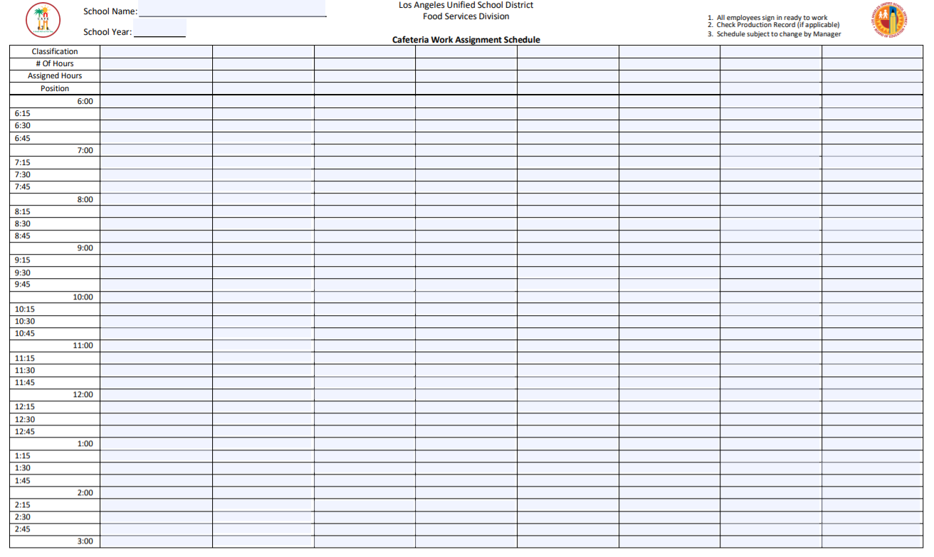
Cafeteria Work Assignment Schedule
The Cafeteria Work Assignment Schedule is used by managers and staff to define the workday.
The form indicates:
Employee names
Tasks
Serving times
Break times
Task timelines
By completing and following schedules, the workday is more efficient and productive.
Notes:
TELL:TELL: When all the information is gathered in written you can now proceed to use the form 38.231, Cafeteria Work Assignment Schedule. Cafeteria Work Assignment Schedule form provides a snap shot the operation in one day.
Key reminders on the form,
Form number can be found on the left hand lower corner of the paper facing you.
On the you will see #1. All employees sign in ready to work
#2 Check production record for meals to be prepared
# Schedule subject to change by Manager

Slide 13
Completing The Cafeteria Work Assignment Schedule
Fill in the following areas:
School name: no abbreviation
School year: current year
Classification: job title
# of Hours: allocated hours for position
Assigned hours: work times
Position: assign alphabetical code
A,B,C, etc.
A
B
C
D
E
F
Notes:
TELL: Before writing the employees schedule, complete the form with the school’s information as well as the employees classification, total number of hours allocated for each employees’, actual working hours, and positions.
TELL: Classification can be written in two ways. Position number for example 4391 is also a Food Service Worker or FSW.

Slide 14

Example
CAFETERIA WORK ASSIGNMENT SCHEDULE SCHOOL: ABC Elementary__ SCHOOL YEAR: 2020-2021_______
Classification | Cafeteria Mgr. | Senior Worker | FSW | FSW
# Of Hours | 8 | 6.5 | 4.0 | 4.0
Assigned Hours | 6:00 - 2:30 | 6:30 - 1:30 | 7:00 - 11:00 | 9:00 - 1:00
Position | A | B | C | D
Notes:
TELL:TELL: Classification can be written in two ways. Position number for example 4391 is also a Food Service Worker or FSW.
Write in the number of hours allocated for each employee.
There is no set rule that all 4 hour employee must start all together at one time frame. Assigned work hours of employees should be based on the cafeteria’s operational needs.
To rotate job duties, general codes such as letters are used instead of names.

Slide 15
Outline Worker Hours
Outlining the working hours of each staff member provides a visual overview of the timeframe’s that tasks can be assigned to staff.
Outline work hours in black ink.
Notes:
TELL: Step 5. Outline in BLACK each of employees working hours.
When blocking off the time schedules be aware that the top of lines indicate the time increments.
I know it over whelming , I don’t know about you …..

Slide 16
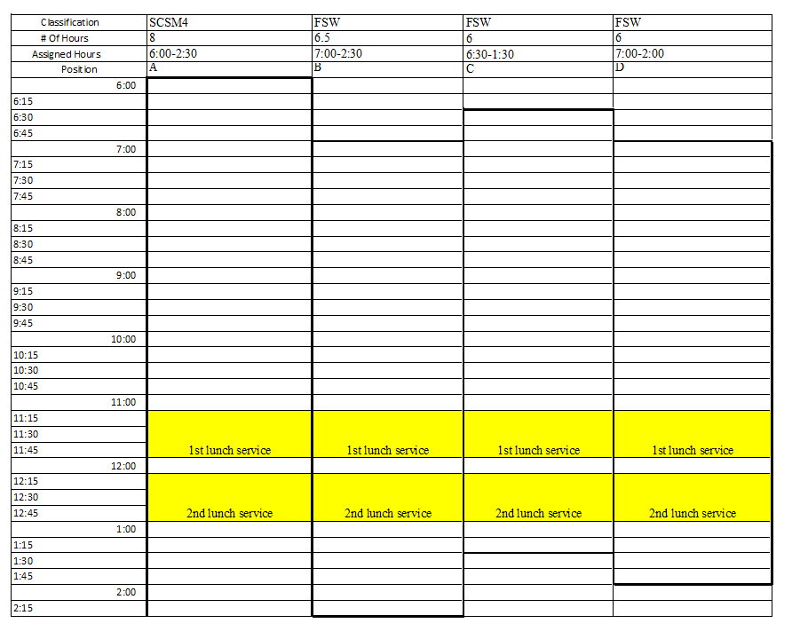
All Hands On Deck!
Before inputting assignments, highlight service times.
All staff must be prioritized to assist with meal service.
Highlight 1st lunch service
Highlight 2nd lunch service
Notes:
TELL: This is an example of a work schedule highlighting the tasks that do not change as deployed to all employees.

Slide 17
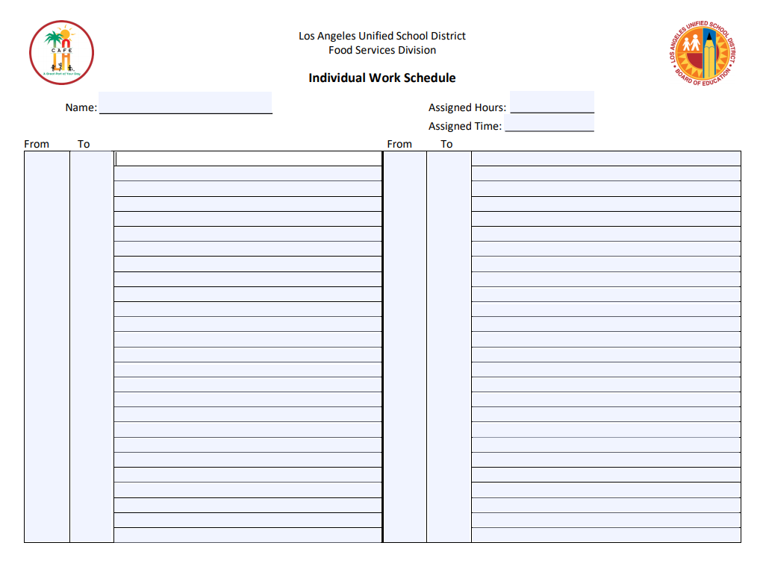
Individual Work Schedule
The Individual Work Schedule outlines the specific job duties of a worker.
Provides timelines for staff to follow
Contains daily assigned duties
Ex. Washing dishes, removing trash, cleaning prep area
Post in highly visible area of the cafeteria
Notes:
TELL: After creating a general work schedule for all cafeteria staff including the manager, an individual work schedule must be written. A comprehensive and chronological individual work assignment must be written for each position, defining the distinction from one position to another.
Refer to the slide.
TELL: This is an example of a Food Service Manager’s individual work schedule.
TELL: An individual work schedule for each employee must be on file and must be maintained for any updates.

Slide 18
Individual Work Schedule Instructions
Fill in the following areas:
Name: Job classification
Assigned hours: Amount of regular work hours scheduled
Assigned time: Start and ending work time
1
2
3
4
5
4. From/To: Exact time frame for the assigned duty
5. Assigned duty: Description of task
Notes:
TELL: After creating a general work schedule for all cafeteria staff including the manager, an individual work schedule must be written. A comprehensive and chronological individual work assignment must be written for each position, defining the distinction from one position to another.
Refer to the slide.
TELL: This is an example of a Food Service Manager’s individual work schedule.
TELL: An individual work schedule for each employee must be on file and must be maintained for any updates.

Slide 19
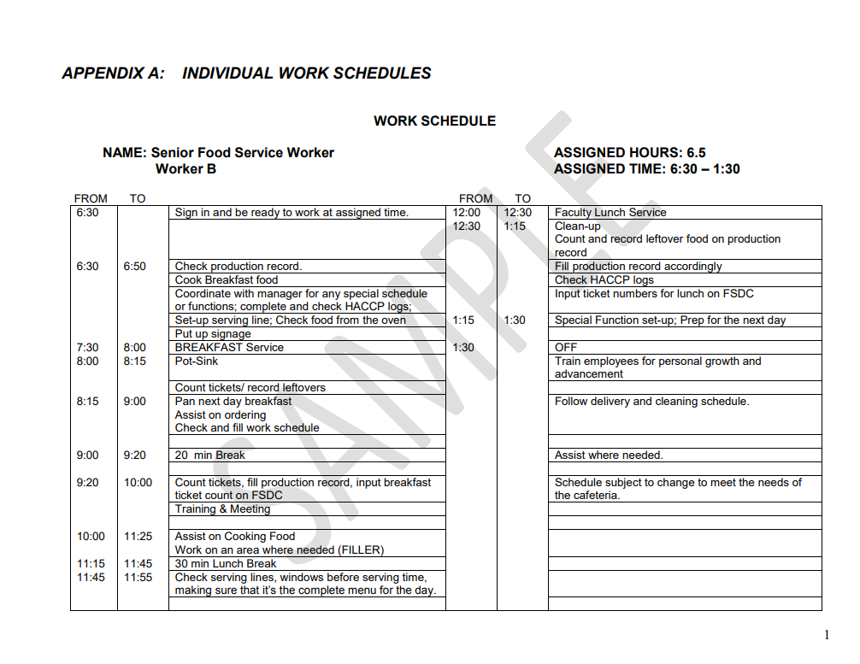
Sample: Individual Work Schedule
Examples of filled areas:
Senior Food Worker, Worker B
Assigned hours: 6.5
Assigned time: 6:30-1:00
From/To: 6:30-6:50
Assigned duty:
1
2
3
4
5
Check production record
Cook breakfast
Notes:
TELL: After creating a general work schedule for all cafeteria staff including the manager, an individual work schedule must be written. A comprehensive and chronological individual work assignment must be written for each position, defining the distinction from one position to another.
Refer to the slide.
TELL: This is an example of a Food Service Manager’s individual work schedule.
TELL: An individual work schedule for each employee must be on file and must be maintained for any updates.

Slide 20
Employee Breaks
When preparing work schedules, employee’s breaks must be included.
6-hour employees
30-minute lunch (unpaid)
Two 10-minute breaks
6.5 hour worker will be there 7 hours
4-hour employees
(1) 10-min break
Breaks can not be taken within the first or last hour of shift.
Employees’ assigned work hours and breaks could be adjusted according to the business needs.
Notes:
TELL: Before we can begin to create a schedule, managers or supervisors must be aware of the basic rules and regulations that can affect a work schedule.
TELL: It is wise to make sure to always check the written statement for any rules than by guessing. Providing employees answers to their questions with the correct information, will avoid any grievances in the future.
TELL: The most commonly neglected part of a work schedule is break time. Let’s all review together the breaks according to our FS Div. employee handbook.
Read Slide: Employees should not arrive from work more than 15 minutes before the beginning of their scheduled time…….
ASK: Can an employee who works six hours and above combine the two ten minutes break?
Yes and must be approved by the SFSM/ AFSS.
ASK: Can an employee leave 10 minutes early to compensate for his/her break?
No.
TELL: We are now aware of the basic rules we must follow in developing a work schedule.

Slide 21


Benefits Of Rotating Between Duties
Rotating duties is a strategy used by managers to be fair and equitable when assigning specific tasks.
By rotating duties, workers will:
Be challenged by new tasks daily
Get a break from strenuous job duties
Gain experience and skills in new areas
The benefits to managers include:
Find workers talents
Identifies a worker's knowledge, skills and attitudes
Gives options when a worker is not there
Notes:
Tell: This is an example of how you can rotate the positions among all the other employees or an opportunity to cross-train.

Slide 22
Analyze Effectiveness
After creating the schedule, step back and analyze the operation. To achieve an effective schedule, follow these best practices:
Make sure schedules are fair and equitable
Observe what is and what is not working in the cafeteria, make changes as necessary
Review your employee’s schedules regularly
Minimum three times a year
When changes to the operations occur; new menu items, added program, new staff, etc.
Collaborate with each staff member to obtain feed back
Notes:
Tell: It’s your turn, now I would like for you to analyze your cafeteria and your daily operations.
You have 3 minutes to list the tasks and / or events that occur in the cafeteria that can affect your work schedule.
After 3 minutes…
Note: Just ask 1 participant to share the list..
Volunteers from the front row.
Tell: Alright 3 minutes is over let’s have a volunteer stand up and discuss the list they have made.
Thank you for participating..

Slide 23

Schedules are Subject to Change
Although schedules are consistent, they are always subject to change depending on business needs.
This statement is to be written on every work schedule.
Notes:
Tell: The following books, studies and website was used to create this power point presentation.

Slide 24
“Plan your work for today and everyday. Then work your plan.”
Notes:
TELL: Please raise your hand if you have any questions.
As I end this class be reminded that the importance of managerial supervision in providing operational excellence, labor cost control and achieving productivity targets cannot be overstated.
A smooth cafeteria operation is dependent upon mainly on the manager’s commitment and expertise in planning, organizing, controlling, motivating employees and utilizing optimally all available tools.
Manager’s or supervisors need to inform employees from the start expectations and explain “why” behind a procedure in order to achieve high standard performance.
Finally for a successful operation a manager must communicate the task in such a way that it gets accepted by those who are supposed to perform that task.
Thank you for your time.

